Slide 1
Pivot & Pivot Table
- Rakesh kumar

Slide 2
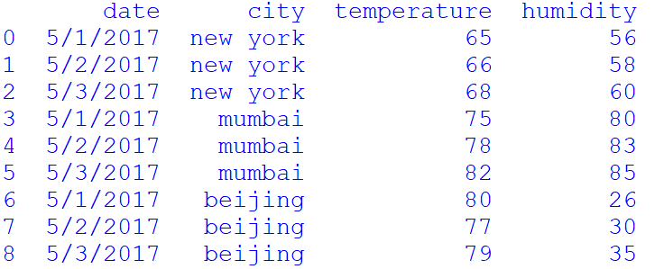
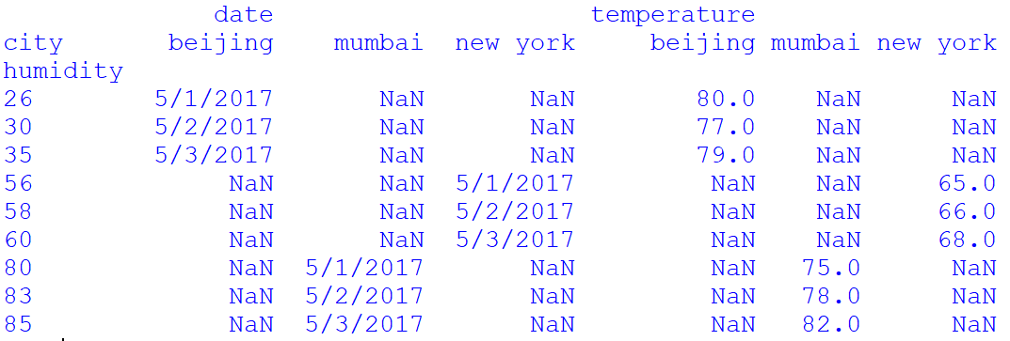
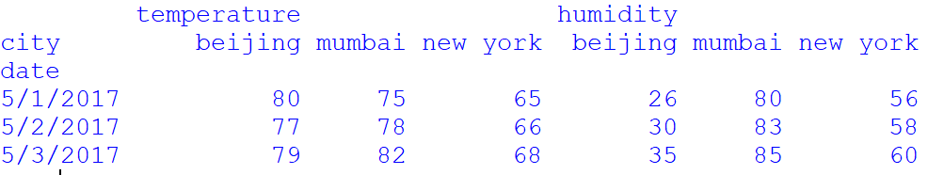
Pivot
Pivot allows you to transform or reshape your dataFrames

Slide 3
Pivot
Pivot() function: It creates a new dataframe after reshaping and transforming the data based on the column values. It takes thrre arguments – index, columns and values. Out of these three arguments, first two arguments are compulsory
Syntax:
Pandas.pivot(index,columns,values)
Where:
Index : It is the column name, used to make new dataFrame’s index
Columns : column name to use to make new dataFrame ‘s columns
Values : It is the column name to use to make new DataFrame’s values. The values paramaters accepts both numeric as well as string

Slide 4
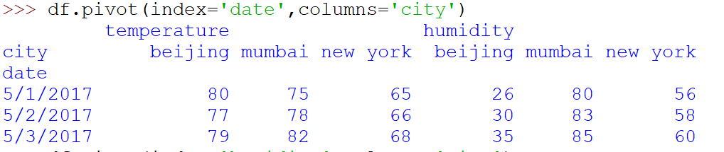
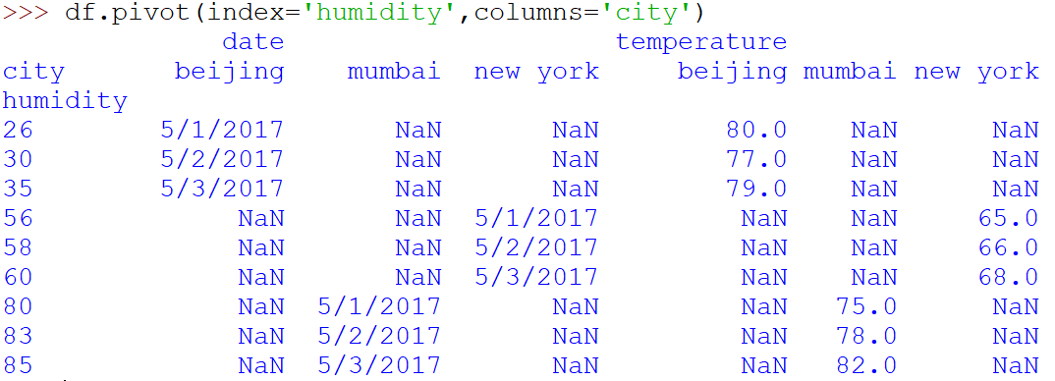
Reshape DataFrame with Pivot()

Slide 5
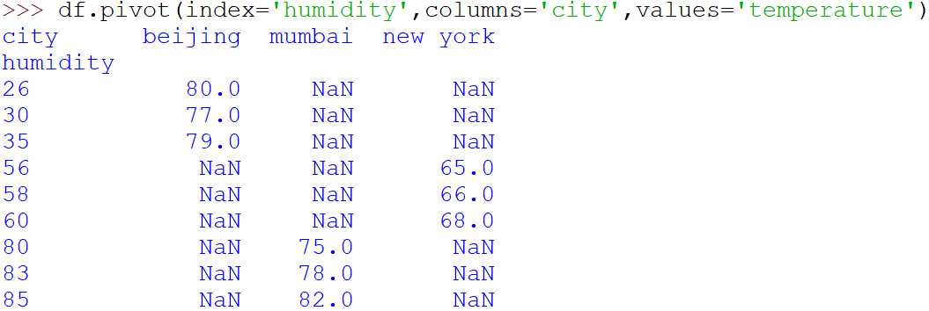
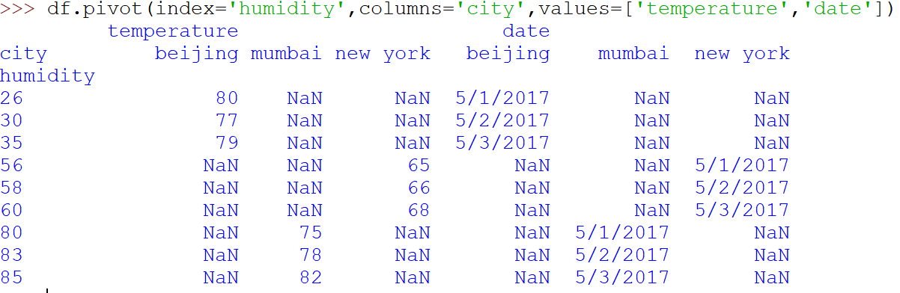

Slide 6
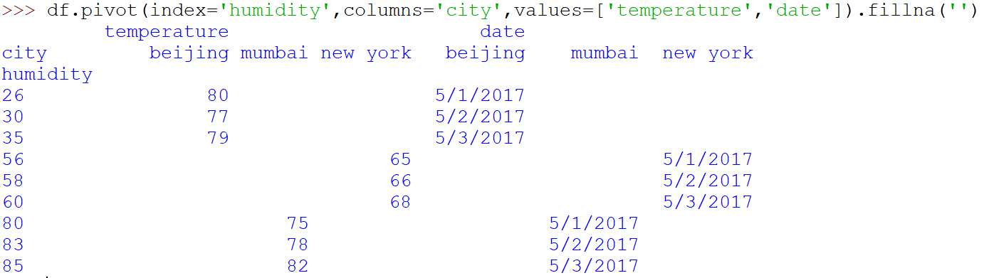
Pivot with fillna

Slide 7
Pivot_table()
pivot_table() is used to summarize and aggregate data inside dataframe

Slide 8
Pivot_table()
Pivot_table() function: it is generalization of pivot() method with summerize function like count, sum, mean and table related functions. This method creates a datafrem and allows grouping of any data field.
pivot_table() is used to summarize and aggregate data inside dataframe
Syntax
Pandas.pivot_table(dataframe,values=none,index=None,Columns=None, aggfunc=‘mean’, fill_value=None, Margins=false, dropna=True,margins_name=‘All’)
Where
DataFrame : This is a pandas DataFrame
Values : This is optional and holds the values of a column to be aggregated
Index : This can be a column, group, array or a list
Columns: This is a column, array or a list
Aggfunc : This is an aggregate function like count, sum, mean, max, min etc
Fill_value: Using this we can fill the default values if the values are missing. The default is NaN
Margins: This is boolean value having default as False. If set True then this will also include total sums along the rows and columns . The total appears in entries whose new column or row labels are ‘All’
Dropna : if this is true then it drops the row having missing values
Margins_name=‘All’ : when margins is True, it will contain names of rows and columns of all the dataset

Slide 9
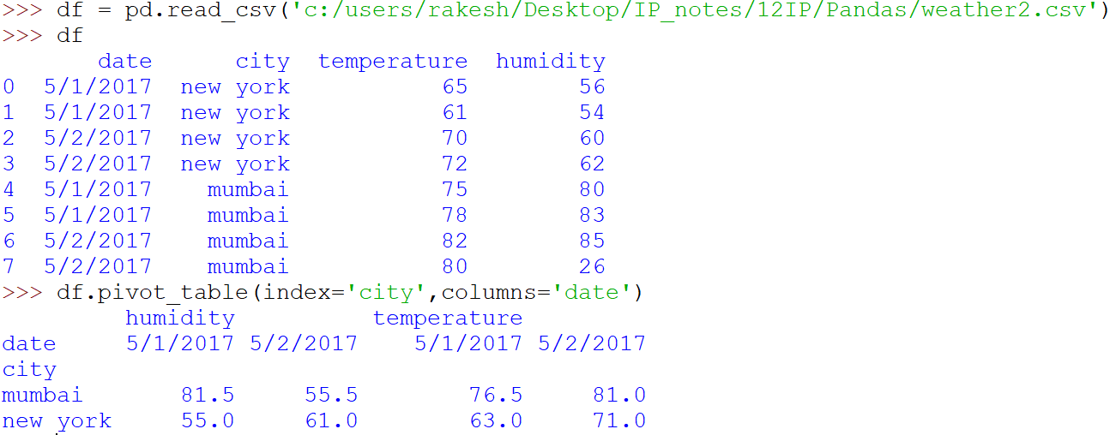
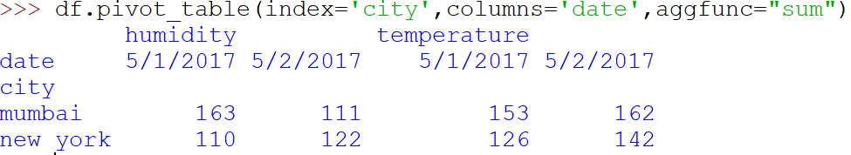
Pivot_table()

Slide 10
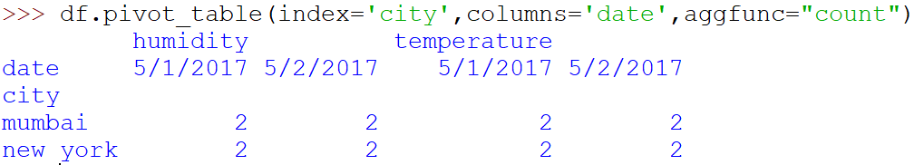
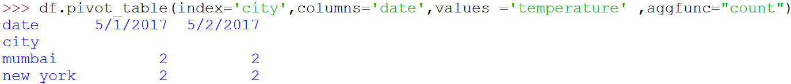
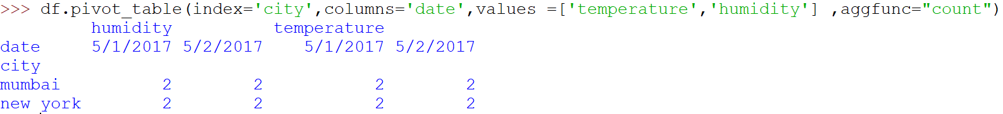
Pivot_table ----- Continued

Slide 11
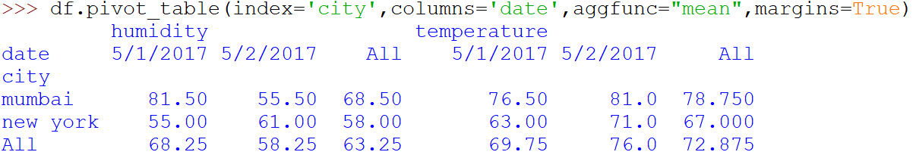
Pivot_table----Contunued…..

